Slide 1
HTML TAGS
MCNDHS
Ms. Eng

Slide 2
AIM: HOW DO WE CREATE IMAGES AS LINKS?
Do now:
step 1: codepen.io
step2:
Daily Grade:
On-time/attendance/not leaving the classroom: 25%
Cellphones: 25%
Notes:25%
Classwork/Homework: 25%

Slide 3
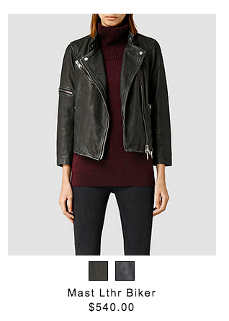

WHERE YOU SEE IT?

Slide 4
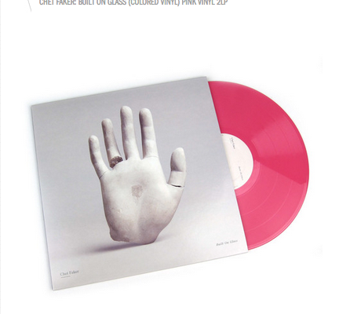

WHERE ELSE DO YOU SEE IT

Slide 5
IMAGE TAG:
<img src=“insert the hyperlink of your image” alt=“write words if its broken” width=“pixels” height=“pixels”>
****No closing tag because you are not adjusting text!

Slide 6
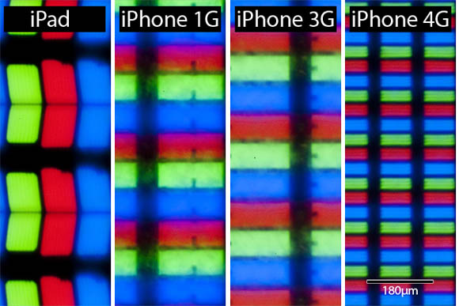
PIXELS

Slide 7
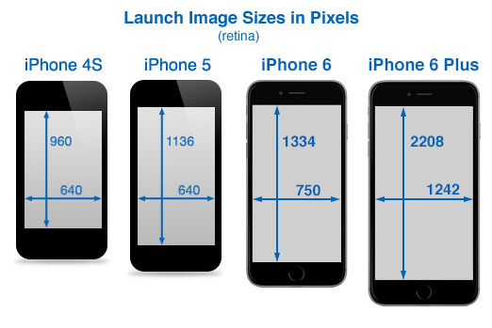
ON YOUR PHONE

Slide 8
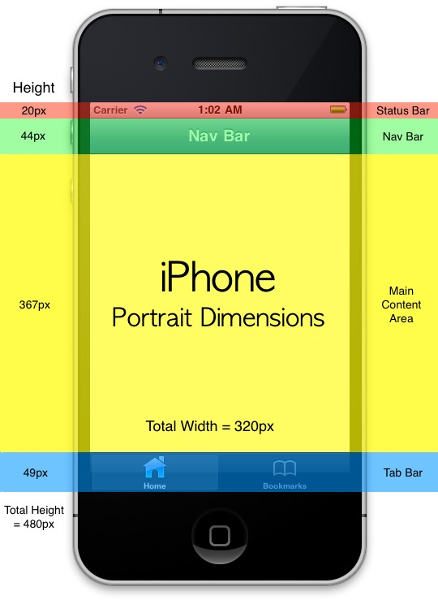
A CLOSER LOOK

Slide 9
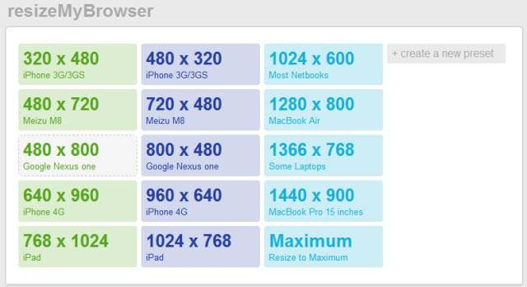
BROWSER

Slide 10
STEP BY STEP
Step 1: Link tag
Step 2: Image tag
Step 3: closing link tag

Slide 11
LOGIC BEHIND WHAT YOU ARE DOING
What ever is in between the link tag will become a link
link tag

Slide 12

ACTIVITY
create three images with the following format:

